Slide 1

TEAM SLYTHERIN
1. SRAVANI BANDARI
2. AKHILA PASAM
3. SANJANA DEVARUPALA
Professor: Erik Fredericks

Slide 2
CONTENTS
1. Project Description
2. Activity Diagram
3. Class Diagram
4. Change Management Plan
5.Technologies Used
6.Wireframes
7.Run Instructions
8.Timeline
9.Conclusion

Slide 3


Project Description
Our main aim of the project is to provide easy window-shopping options to the user with various categories.
Our project is an ecommerce website having features such as login, adding items to cart, Summing the prices of the items and displaying the final price to the user, proceeding to payment and checking out.
The website has been built with the hope of providing user friendly and platform adaptable website to the user.
This Photo by Unknown author is licensed under CC BY-NC.

Slide 4
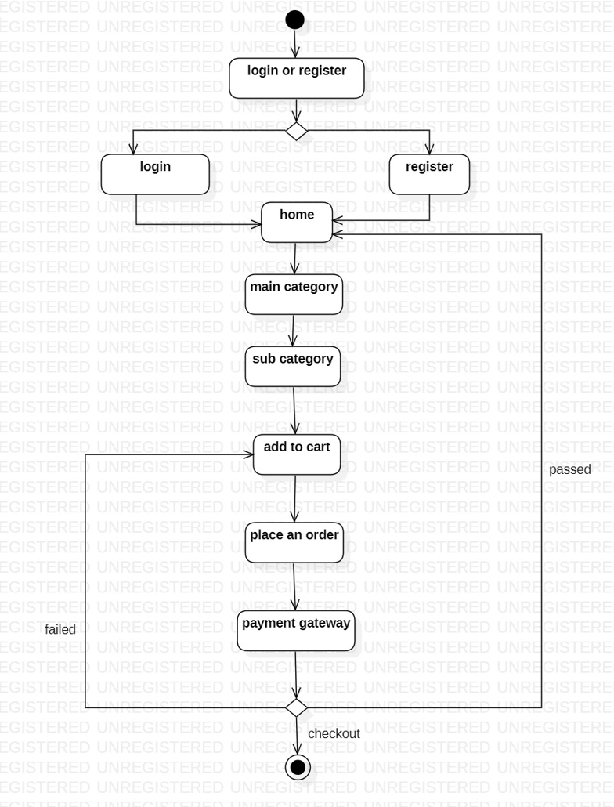
ACTIVITY DIAGRAM

Slide 5
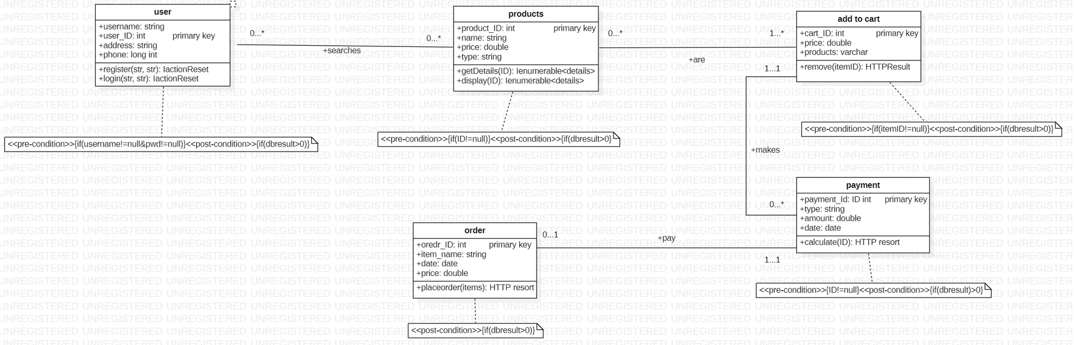
CLASS DIAGRAM

Slide 6

TECHNOLOGIES USED
FRONTEND: HTML,CSS,BOOTSTRAP,JAVA SCRIPT
BACKEND: JAVA,JDBC
DATBASE: MySQL

Slide 7
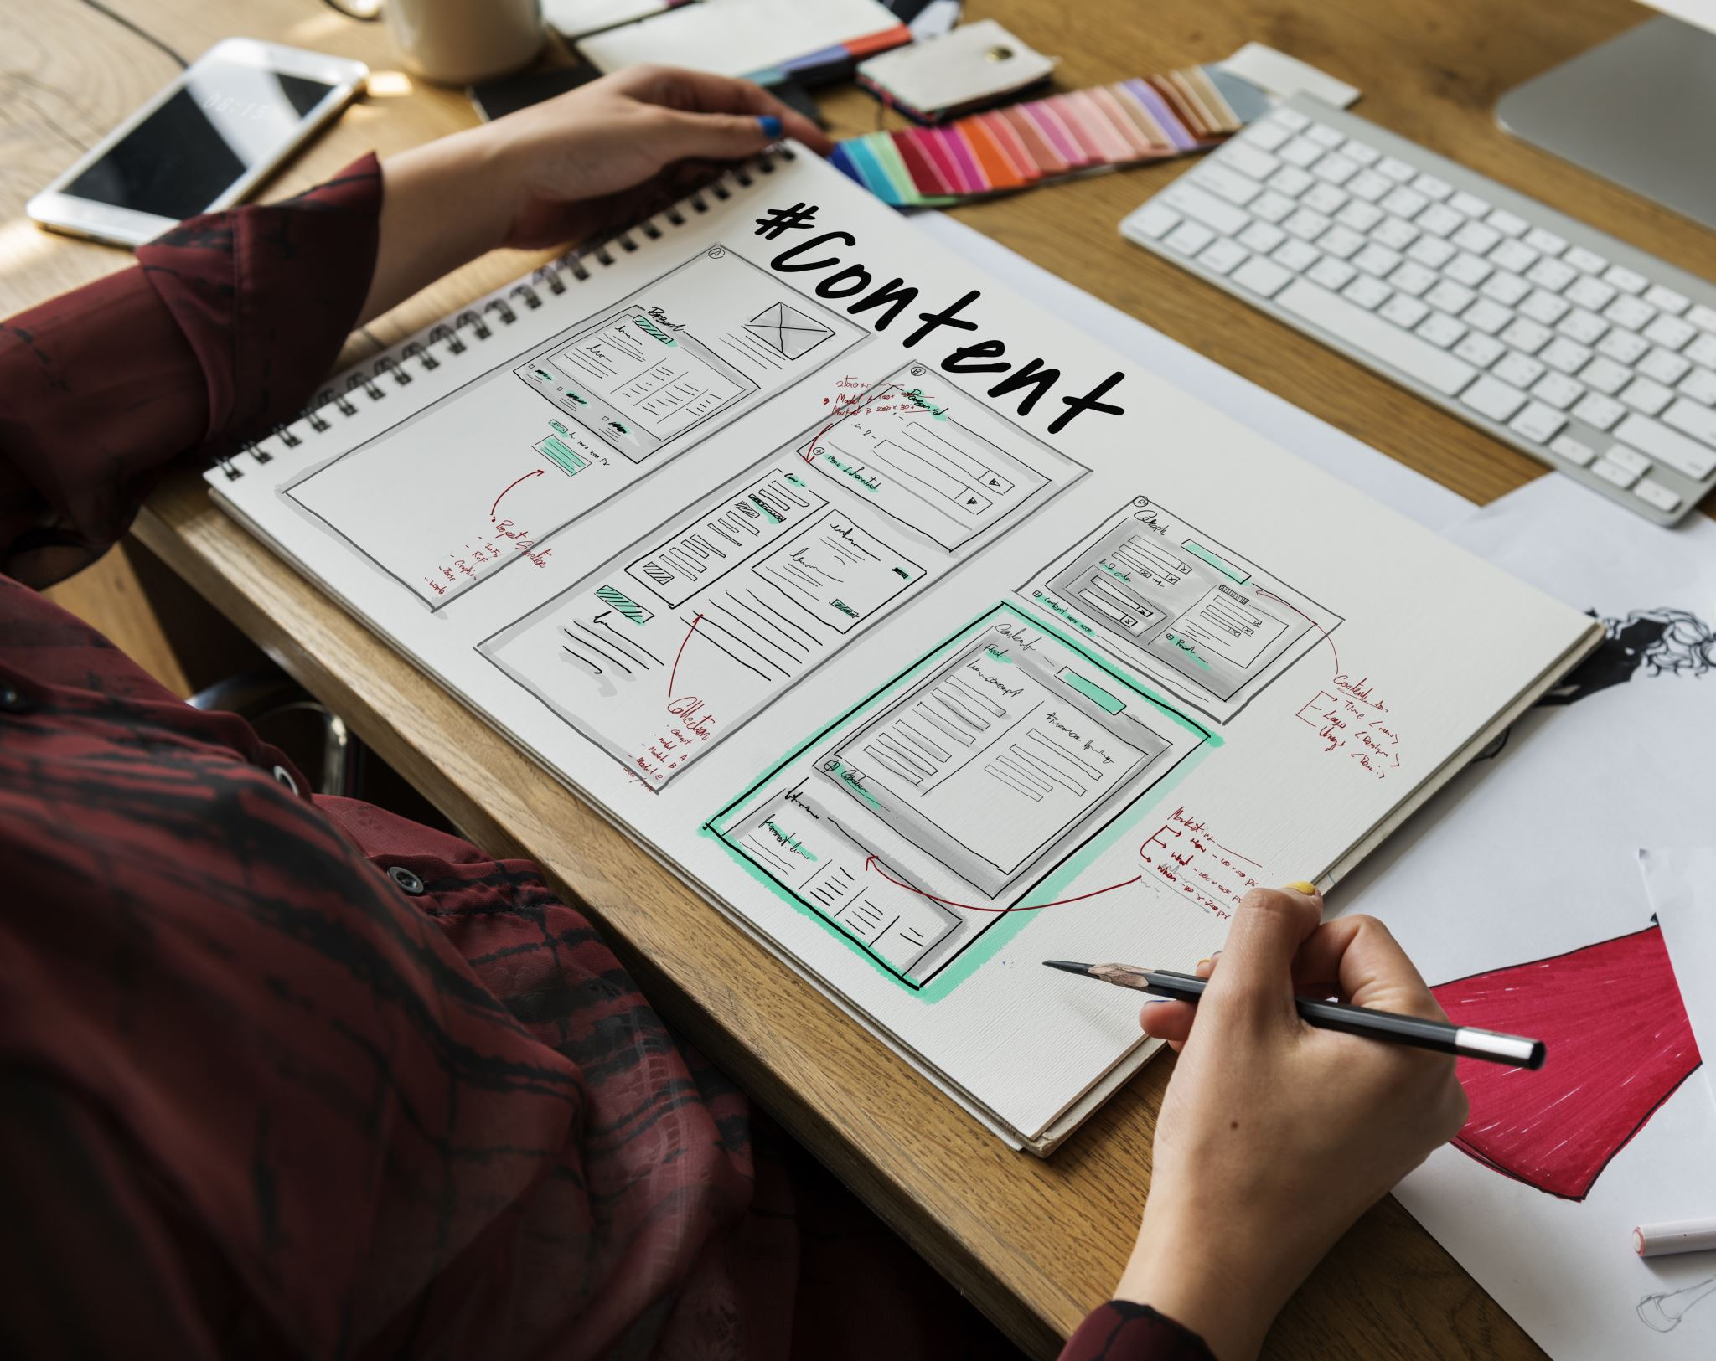
CHANGE MANAGEMENT PLAN

Slide 8
Whenever organization makes any change to website or the application, it needs to be accustomed by the user as well as employees. So we need a plan for that called as change management plan.
Notes:
S

Slide 9
HOW?
Train people on website use
Integrity with ecosystem /software
Discovering the issues

Slide 10
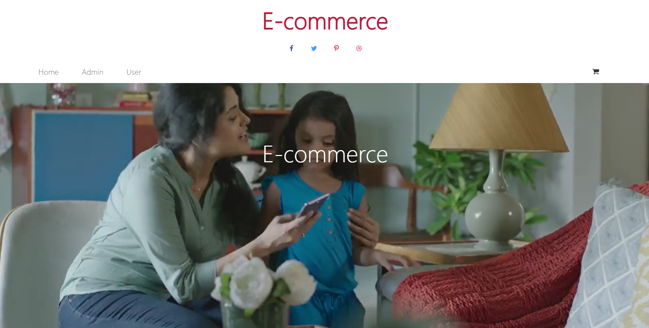
WIRE FRAMES

Slide 11
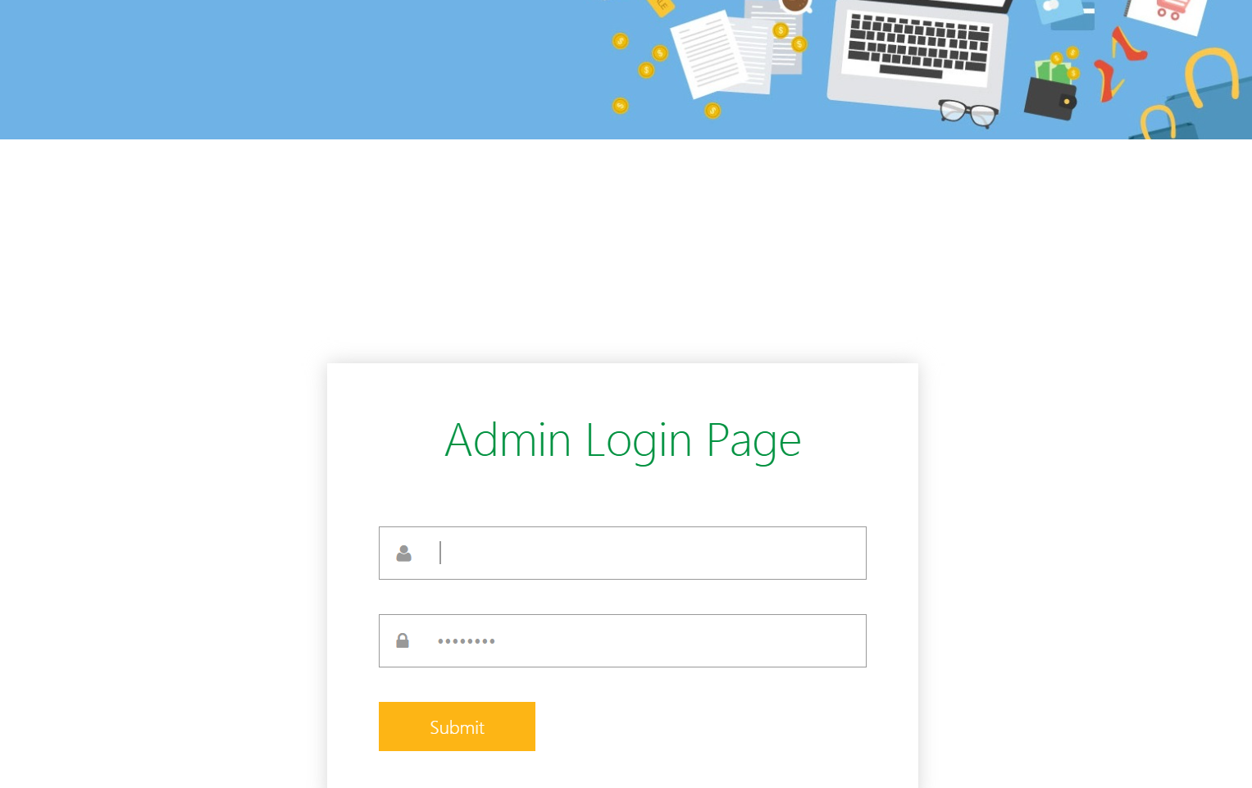
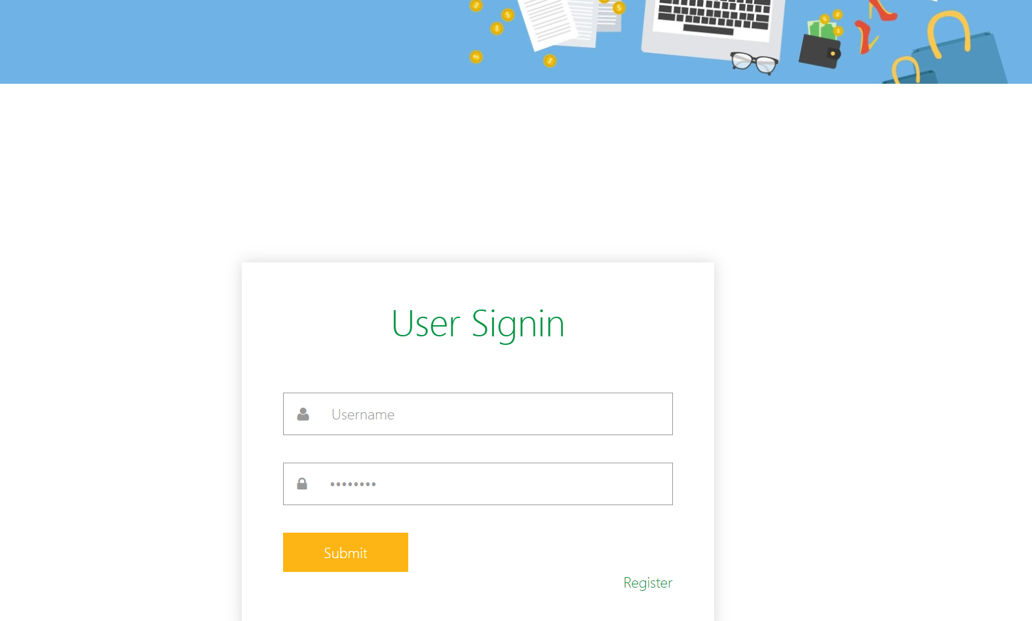
LOGIN PAGES OF ADMIN&USER

Slide 12
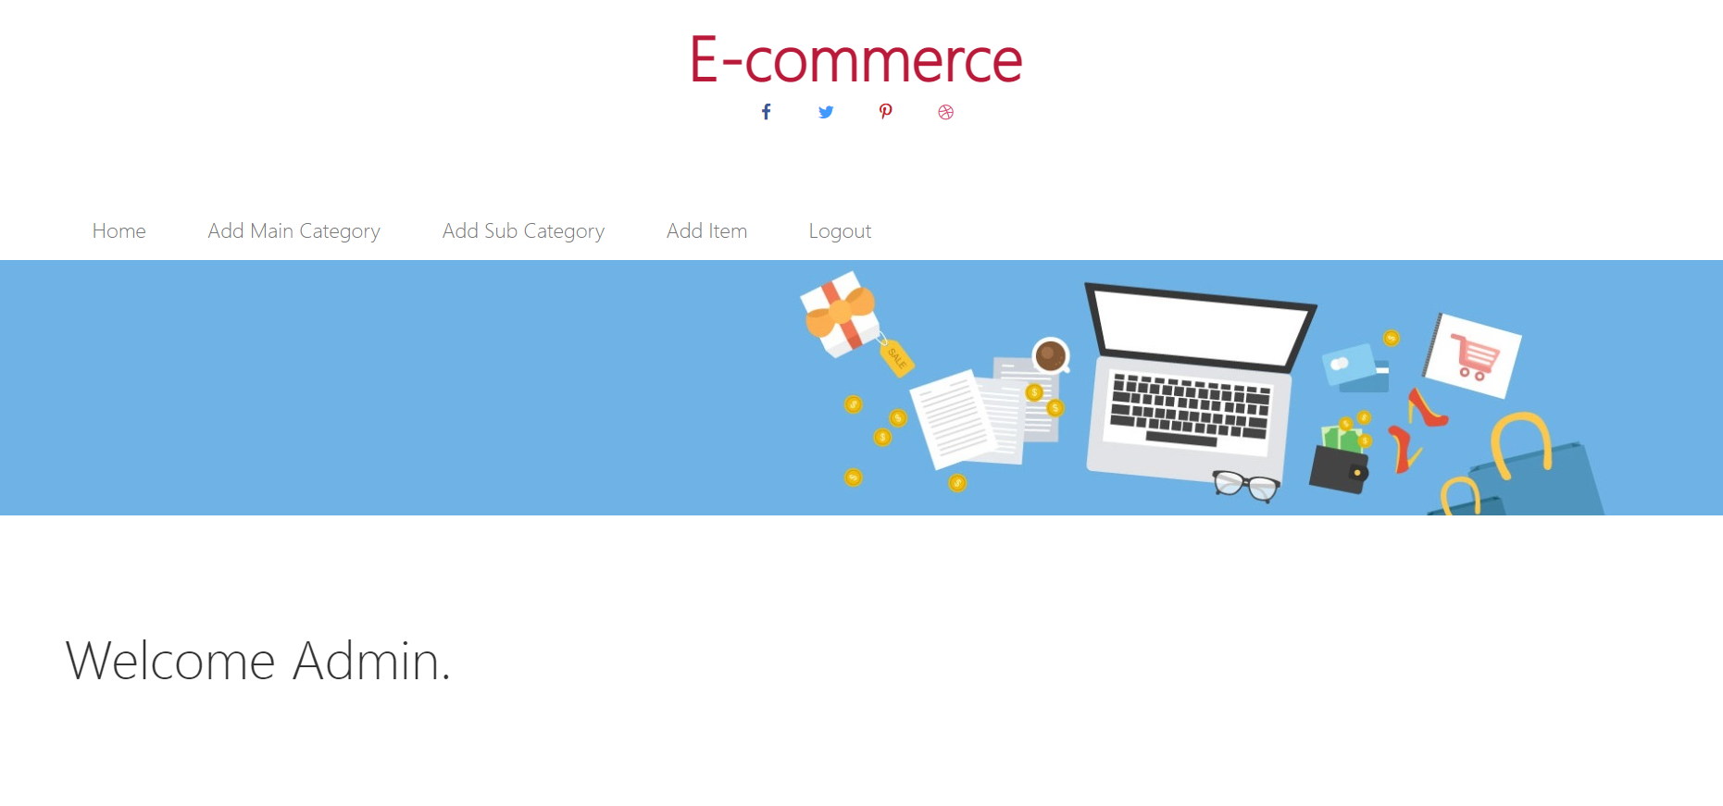
HOMEPAGE OF ADMIN

Slide 13
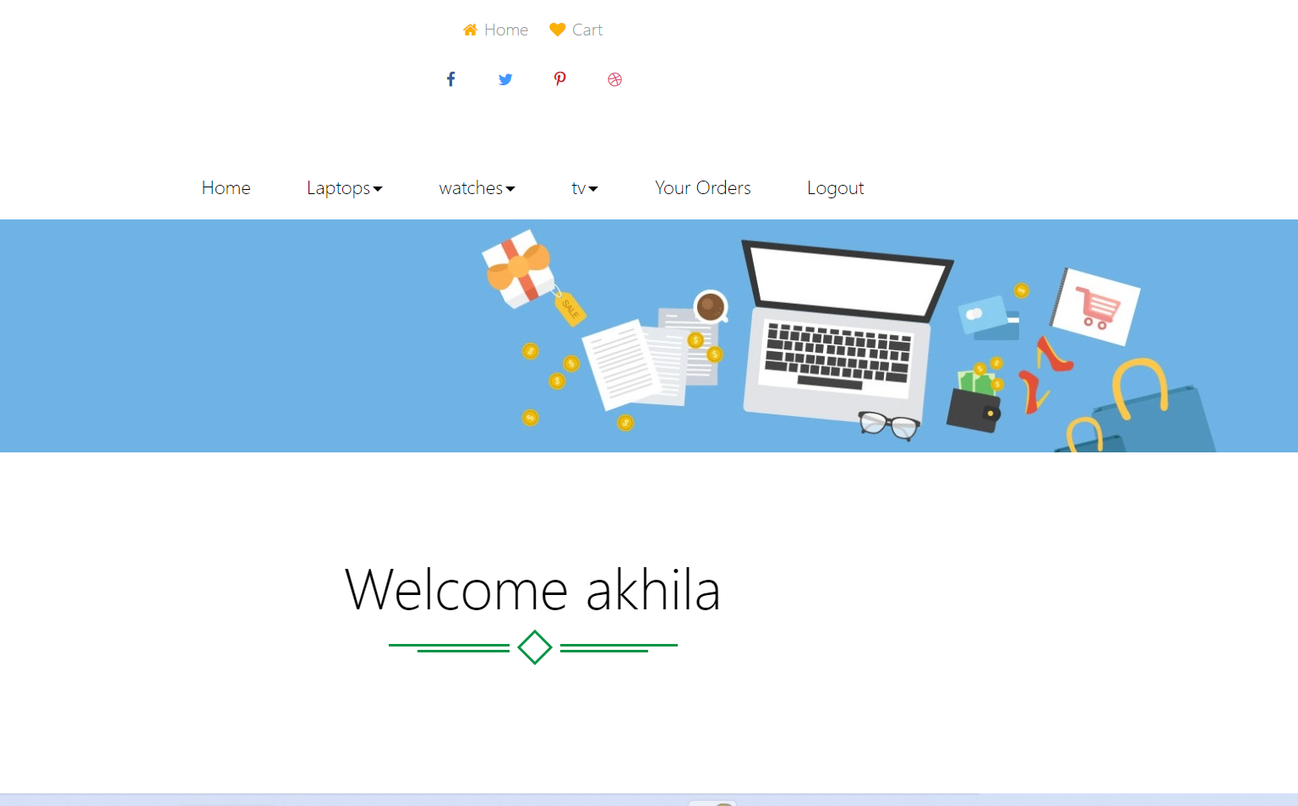
HOME PAGE OF USER

Slide 14
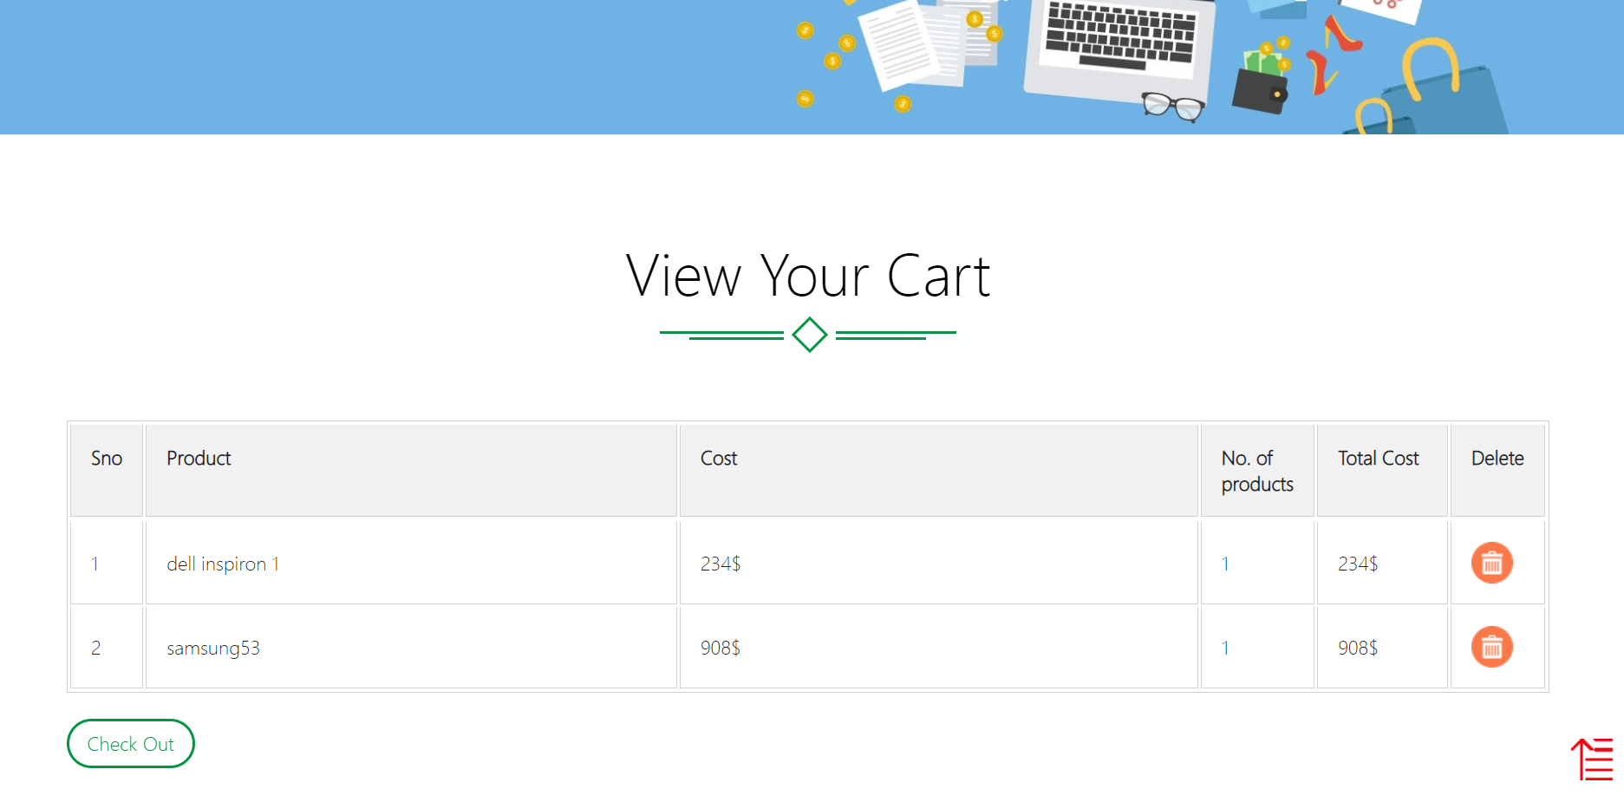
CART PAGE

Slide 15
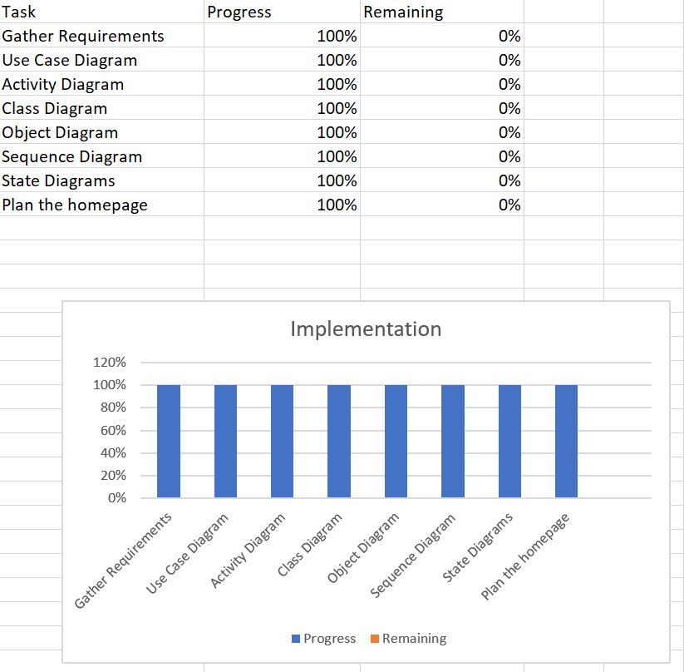
TIMELINE

Slide 16
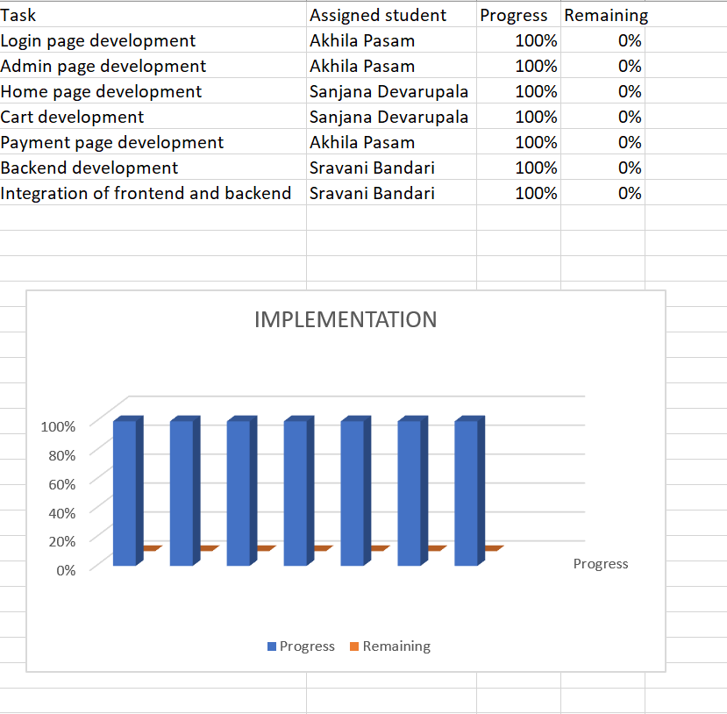

Slide 17
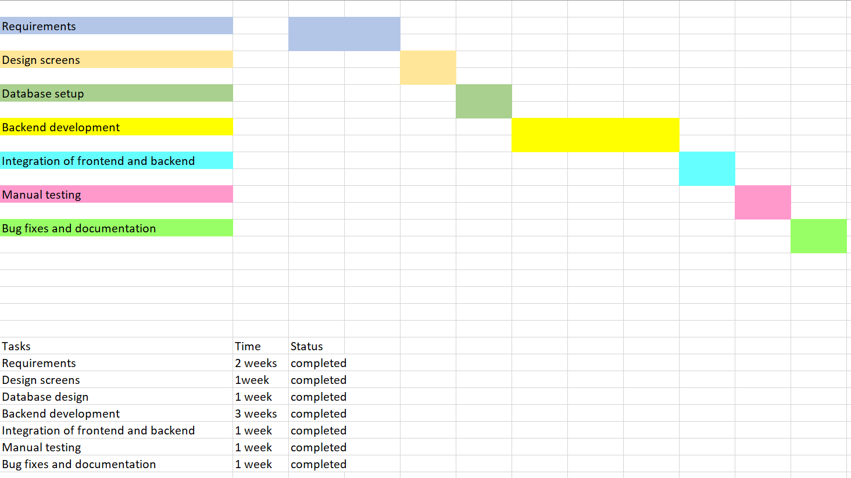
GANTT CHART

Slide 18
RUN INSTRUCTIONS
Clone the project from (https://github.com/sravanibandari/GVSU-CIS641-Slytherin.git)
Install Apache Tomcat 8.0,MySQl 5.0,SQLyog 6,Java
Initiate Tomcat Apache Server and Sqlyog
Once the Tomcat Server is started,Open the link (http://localhost:2022/ECommerce/)
Go to manager app,select Ecommerce application
Website will start running

Slide 19
CONCLUSION
In general, today's businesses must always strive to create the next best thing that consumers will want because consumers want their products, services, and so on to be better, faster, and cheaper all the time.
E-commerce is constantly evolving and becoming increasingly important to businesses as technology advances, and it is something that should be taken advantage of and implemented.

Slide 20


